Slide 1

MADHAV INSTITUTE OF TECHNOLOGY & SCIENCE, GWALIOR (A Govt. Aided UGC Autonomous & NAAC Accredited Institute, Affiliated to RGPV, Bhopal) Department of CSE & IT
MINOR PROJECT II
(150606)
RestoSoochi – QR code Menu for restaurants
SUBMITTED TO: SUBMITTED BY:
Prof. Amit Kumar Manjhwar Kapil Patel(0901CS181050)
Prof. Jamvant S. Kumare Karan Sharma(0901CS181051)
Karishma Raghuwanshi(0901CS181052)
Manasi Shrivastava(0901CS181058)

Slide 2
INTRODUCTION

Slide 3
Coronavirus has turned the humble QR code into an everyday essential
QR codes have been dismissed as a marketing gimmick – but in our touch-free world, they’re proving their worth
-Wired (Oct’20)

Slide 4
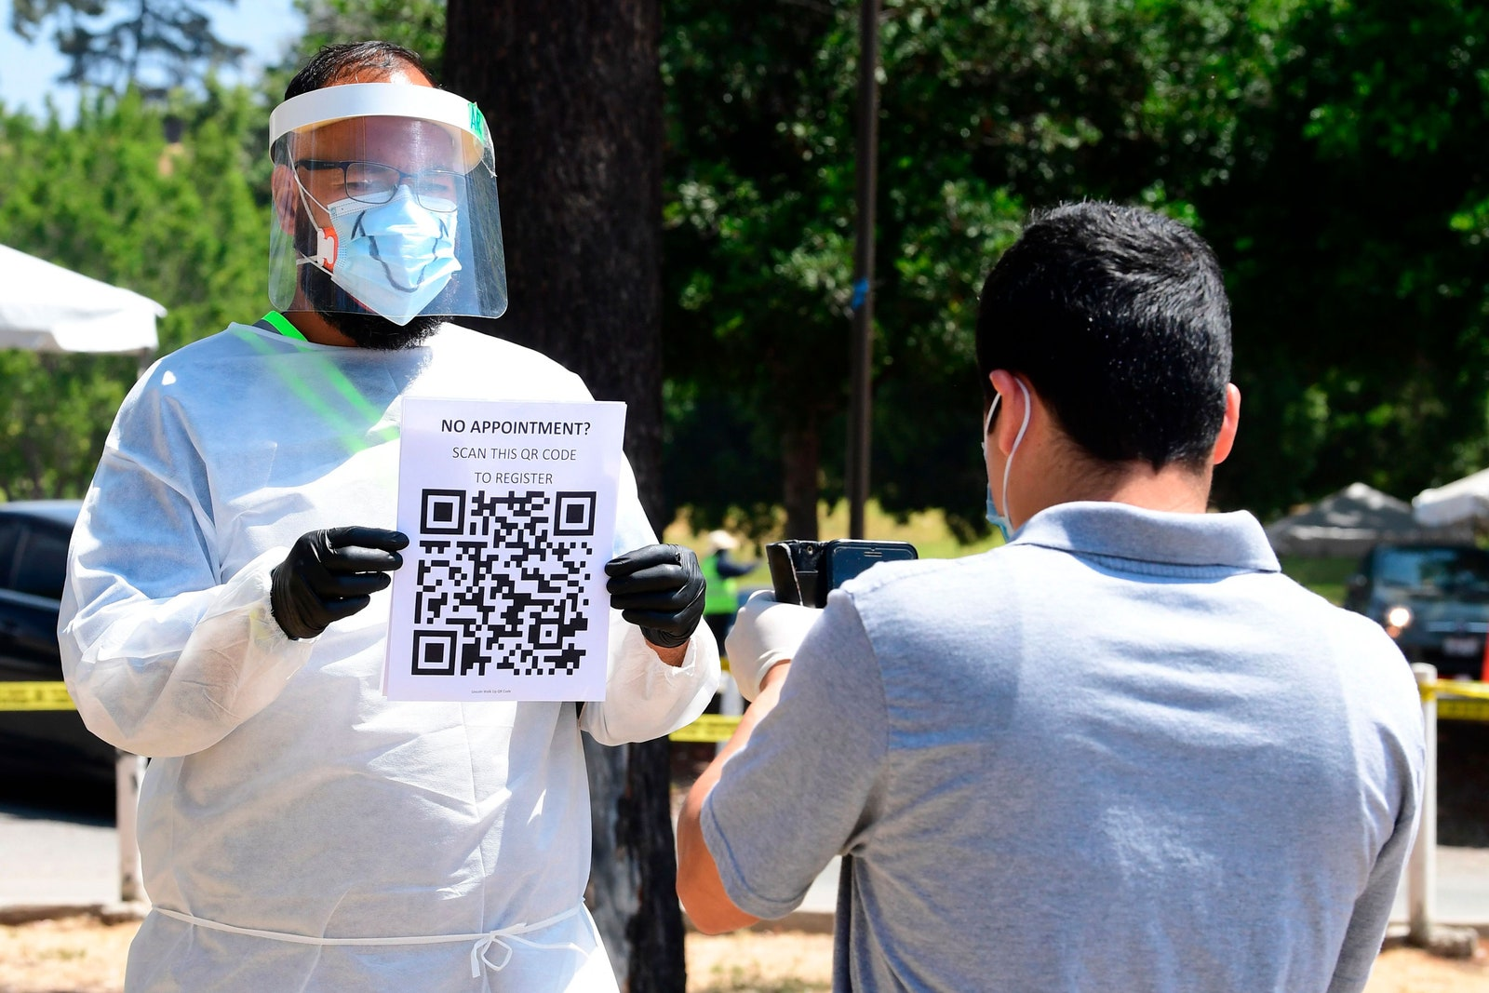
CORONAVIRUS AND THE QR CODE
As the hospitality industry begins tentatively to open up, restaurants and hotels are turning to technology to deliver a dine-in experience that is as touch-free as possible. Suddenly, a card menu that gets passed through the germy hands of one customer to the next doesn’t seem so appealing.
QR codes – the black, barcode-like squares that can point to text or a website – have been around for a while, but was previously dismissed as largely a marketing gimmick, at least in a consumer context. Now the QR code has found its time to shine.

Slide 5
PROJECT OVERVIEW & OBJECTIVES

Slide 6
FOR RESTAURENTS AND SMALL BIZ OWNERS:
They can set, update and edit their menus; food category-wise, items, quantities and prices on the fly without having to worry about the printing costs and customer usage. Helps in maintaining a healthy rapport and communication between the business owners and customers with the help of feedback and grievances slots.
Admins have to be signed in to their RestoSoochi accounts.

Slide 7
FOR THE USERS/CUSTOMERS:
Features QR codes that customers point and scan with their smartphone’s camera, taking them to an online digital menu where they can browse food and drink options. Including pre-ordering before users arrive at a restaurant, ordering through the digital menu at their table, liable to a time limit on the order and payment processing.
Users can easily check-in, get stuff done and check out from their accounts.
More features:
Users can pre-book tables; specifying the strength of the party and type of the food options. They can place orders before/on arrival according to their needs.

Slide 8
TECHNOLOGY PLATFORM OVERVIEW

Slide 9
TECHNOLOGY PLATFORM OVERVIEW
Front-end languages:
HTML, CSS, JavaScript
Back-end languages:
Python, Django
Database:
MySQL
Platform:
Visual Studio Code, PyCharm

Slide 10
APPLICATION FEATURE OVERVIEW

Slide 11
APPLICATION FEATURE OVERVIEW
Ordering and reservations
Order placement(for takeout delivery).
Table reservation and pre-booking included to serve more customers with intuitive order management portal.
All-inclusive software
A digital menu including photos and detailed information. Whether a chain or a single outlet, site supports all restaurant businesses.
Digitized menu
Branded mobile menu that can be created and modified online. Admins can increase average order value with upselling and cross-selling tools.
Quick serve
Speed up table turns, better manage in-store/online orders anywhere. Facilitates meal-management if you’re serving only lunch menu with just one click.
Optimized experience
Mobile optimized QR menu scanning system to access the menu on their mobile phones efficiently.
24/7 support and direct communication.
User reviews and ratings to support store owners and customers round the clock.

Slide 12
IMPLIMENTATION

Slide 13
Our process is easy
Additionals
Users can place orders, browse and book tables. Can leave reviews and ratings.
03
Admin
Here admin(restaurant owners) check into their accounts and set up their personalised menus, complete with categories, quantities and prices in our database.
01
02
User
Users(customers/guests) can register and log-in and scan the QR codes from the menus provided at the stores and can access the digitised menu in that module.

Slide 14
APPLICATION SNAPSHOTS

Slide 15
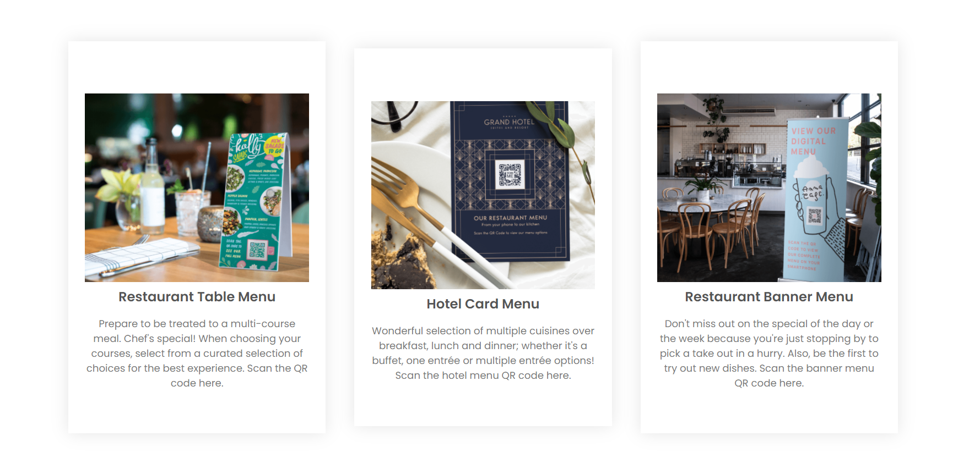
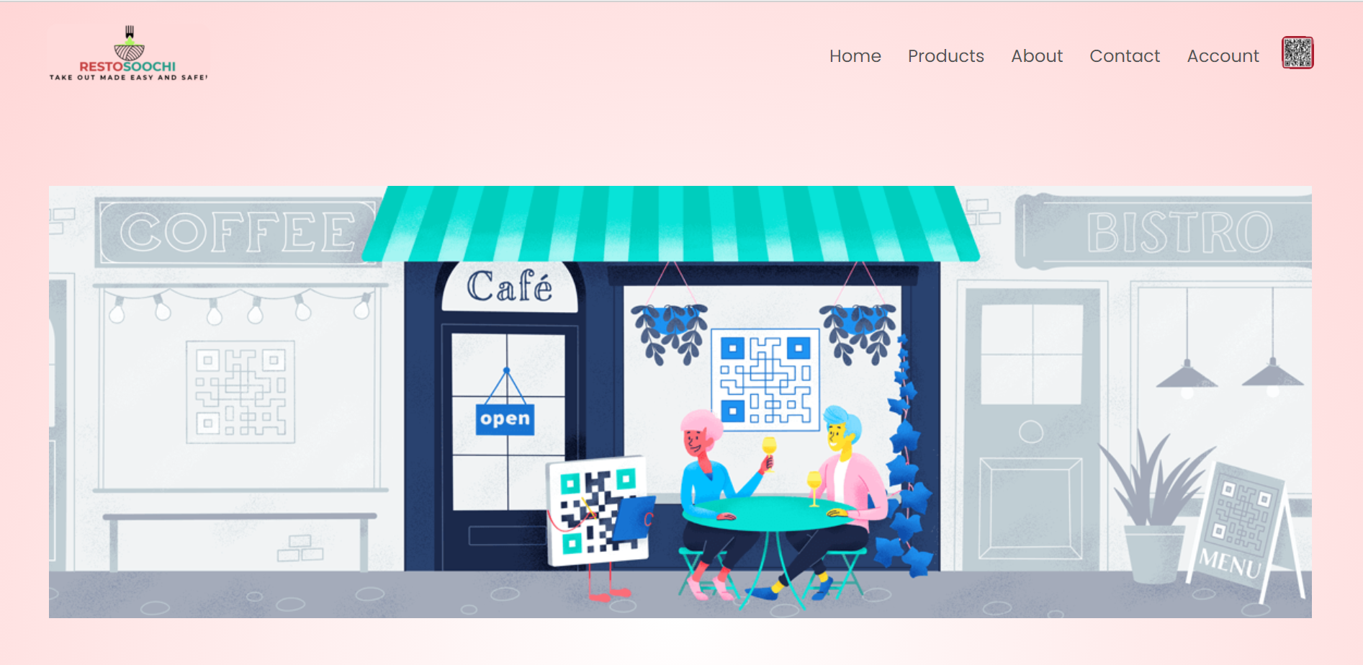
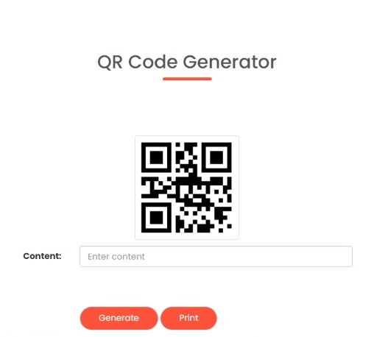
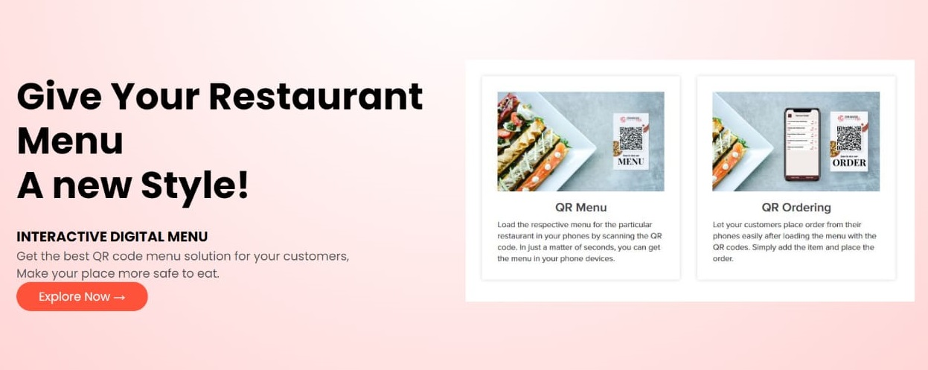

Slide 16
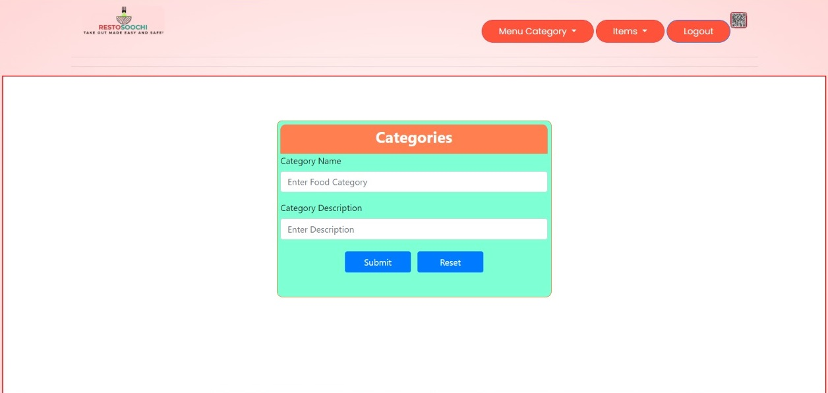
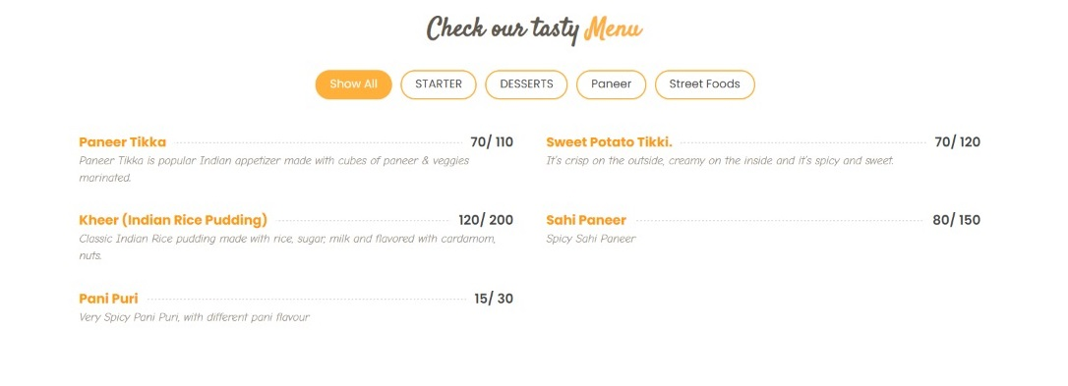
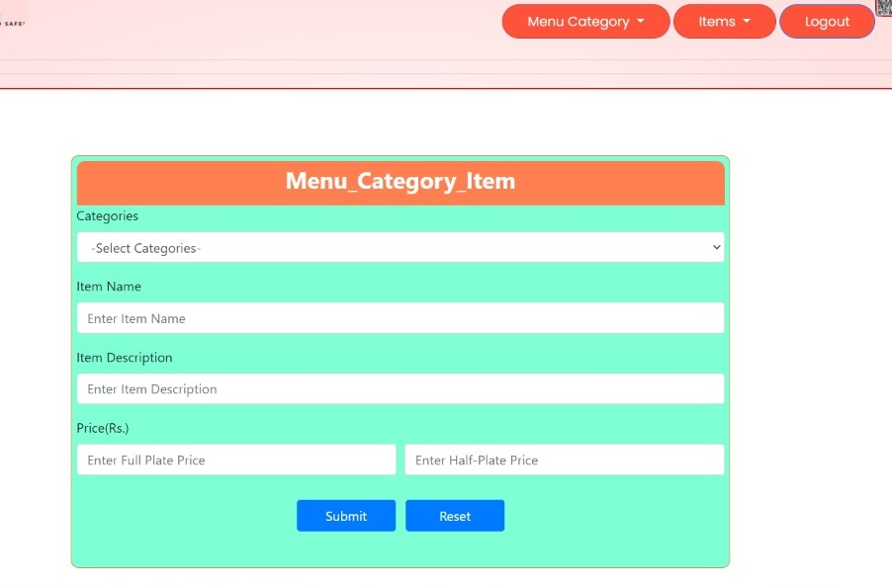
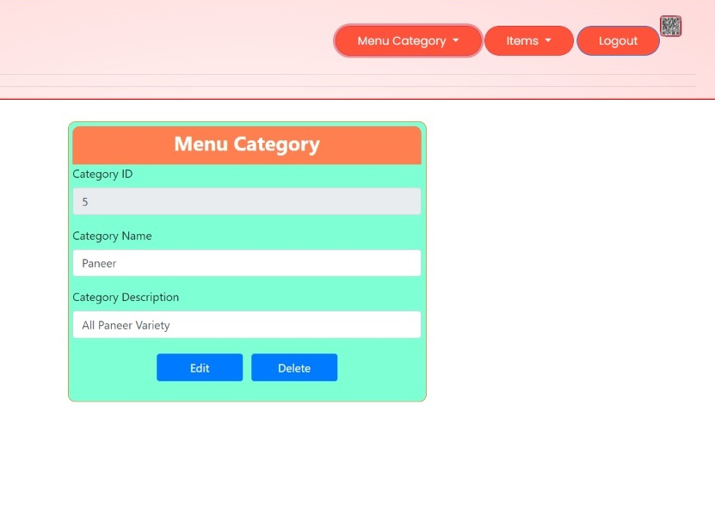
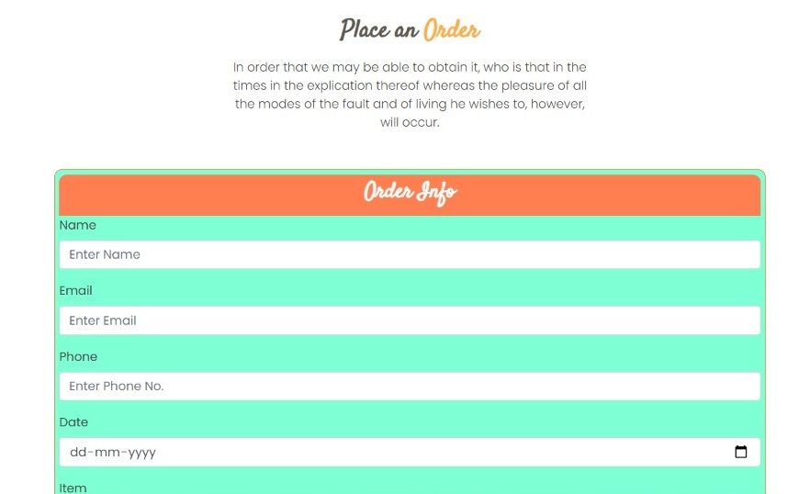
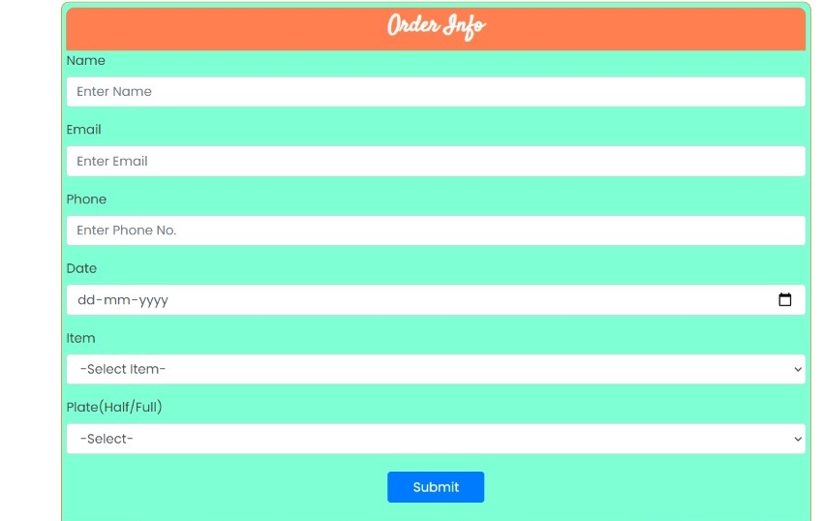

Slide 17
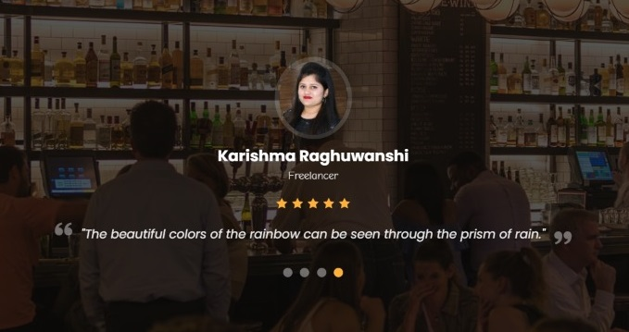
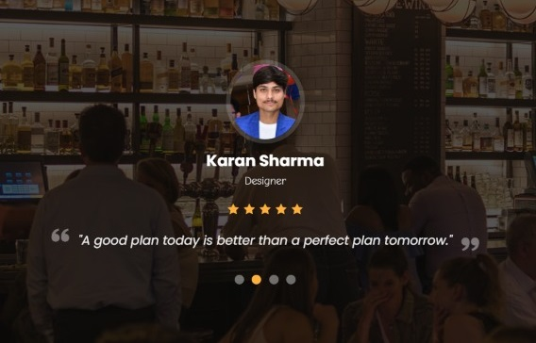
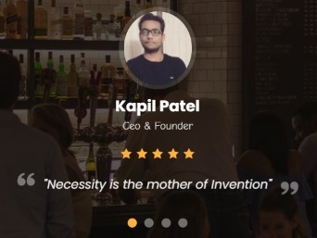
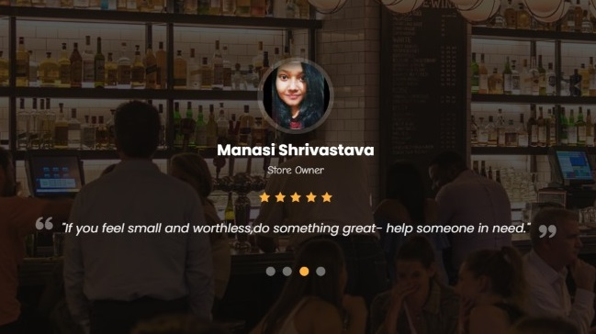

Slide 18
FUTURE WORK

Slide 19
FUTURE WORK
Work out a more personalised experience:
Get full access to customers data and personalize their experience with analytics and UX.
Adding Tips in checkout:
Allow the users to add tips during the checkout.
Multiple payment options:
Google pay, PhonePe, PayTM, MobiKwik, etc, to further facilitate contactless cashless restaurent experience.
SMS notifications:
Send order details, kitchen status, and payment summary via SMS.

Slide 20
CONCLUSION

Slide 21
CONCLUSION
We have created a functioning website with dynamic QR codes to deliver a safe and seamless on-premise dining experience to the guests with our QR-menu order system, complete with takeaway and delivery.

Slide 22
Thank You!

